Slide 1
CSC130 Data Structures and Algorithm Analysis
Fall 2016, Lecture 21
Instructor: Dr. Yuan Cheng

Slide 2
Session Plan
Edge-Weighted Graphs
Shortest-Path Problem

Slide 3
Edge-Weighted Graphs
In an edge-weighted graph, each edge has an associated numerical value, called the weight of the edge
Edge weights may represent, distances, costs, etc.
Example:
In a flight route graph, the weight of an edge represents the distance in miles between the endpoint airports
849
PVD
1843
ORD
142
SFO
802
LGA
1743
1205
337
1387
HNL
2555
1099
LAX
1233
DFW
1120
MIA

Slide 4
Shortest Path Problem
Given a weighted graph and two vertices s and t, we want to find a path of minimum total weight between s and t.
Length of a path is the sum of the weights of its edges.
Example:
Shortest path between Providence and Honolulu
Applications
Internet packet routing
Flight reservations
Driving directions
849
PVD
1843
ORD
142
SFO
802
LGA
1743
1205
337
1387
HNL
2555
1099
LAX
1233
DFW
1120
MIA

Slide 5
Shortest Path Properties
Property 1:
A subpath of a shortest path is itself a shortest path
Proof: “Cut-and-paste”
Property 2:
There is a tree of shortest paths from a start vertex to all the other vertices
A shortest-paths tree (SPT) is a subgraph containing s and all the vertices reachable from s that forms a directed tree rooted at s such that every tree path is a shortest path in the digraph
Example:
An SPT from Providence
849
PVD
1843
ORD
142
SFO
802
LGA
1743
1205
337
1387
HNL
2555
1099
LAX
1233
DFW
1120
MIA

Slide 6
Shortest Path Variants
Which vertices?
Single source: from one vertex s to every other vertex
Single sink: from every vertex to one vertex t
Source-sink: from one vertex s to another t
Restrictions on edge weights?
Unweighted
Non-negative weights
Euclidean weights
Arbitrary weights
Cycles?
No directed cycles
No “negative cycles”
Simplifying assumption: each vertex is reachable from s

Slide 7
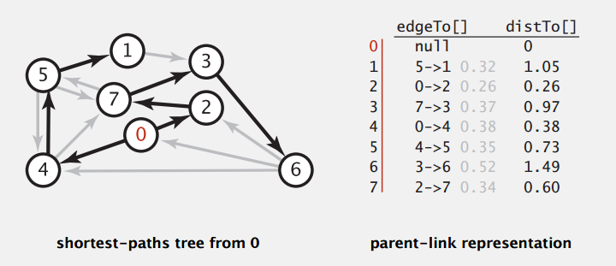
Single-Source Shortest Path
Goal: Find the shortest path from s to every other vertex
Observation: A shortest path tree solution exists
Consequence: Can represent the SPT with two vertex-indexed arrays:
distTo[v] is length of shortest path from s to v.
edgeTo[v] is last edge on shortest path from s to v.

Slide 8
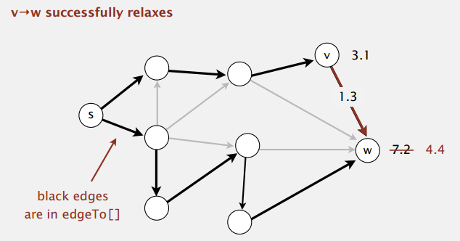
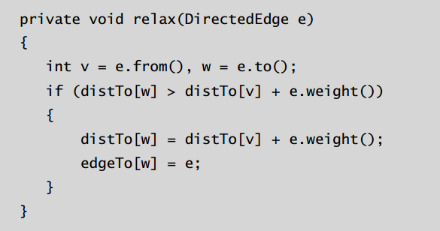
Edge Relaxation
Relax edge e = v->w
distTo[v] is length of shortest known path from s to v
distTo[w] is length of shortest known path from s to w
edgeTo[w] is last edge on shortest known path from s to w
If e = v->w gives shorter path to w through v, update both distTo[w] and edgeTo[w]

Slide 9
Shortest-Paths Optimality Conditions
Proposition: Let G be an edge-weighted digraph. Then distTo[] are the shortest path distances from s iff:
distTo[s] = 0
For each vertex v, distTo[v] is the length of some path from s to v
For each edge e = v->w, distTo[w] ≤ distTo[v] + e.weight()
Proof: (P650 on Sedgewick et al.)
<=[necessary]
=>[sufficient]

Slide 10
Generic Shortest-Path Algorithm
Initialize distTo[s] = 0 and distTo[v] = ∞ for all other vertices
Repeat until optimality conditions are satisfied:
Relax an edge
How to choose which edge to relax?
Dijkstra’s algorithm (non-negative weights)
Topological sort algorithm (no directed cycles)
Bellman-Ford algorithm (no negative cycles)

Slide 11
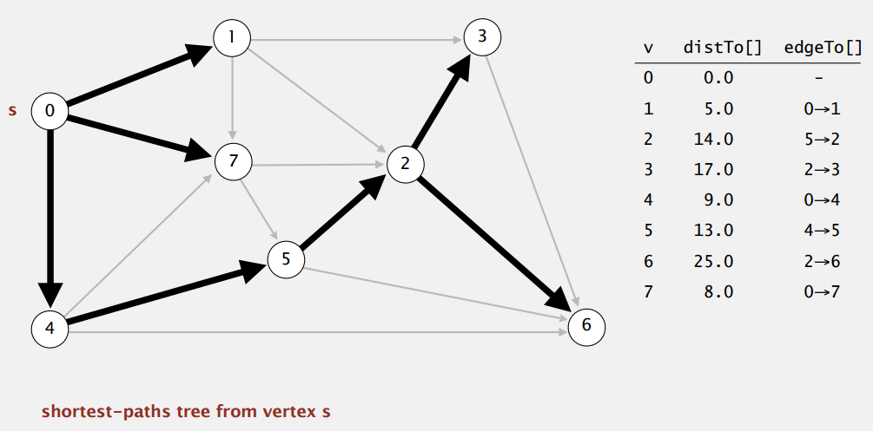
Dijkstra’s Algorithm
Consider vertices in increasing order of distance from s (non-tree vertex with the lowest distTo[] value)
Add vertex to tree and relax all edges adjacent from that vertex

Slide 12
Dijkstra’s Algorithm Example
0
0
8
A
4
8
A
4
2
2
8
7
2
1
4
8
7
2
1
3
B
C
D
B
C
D
∞
3
9
∞
5
3
9
8
2
E
F
5
2
E
F
5
0
0
8
A
4
8
A
4
2
2
8
7
2
1
3
7
7
2
1
3
B
C
D
B
C
D
5
3
9
11
5
3
9
8
2
E
F
5
2
E
F
5

Slide 13
Dijkstra’s Algorithm Example (cont.)
0
8
A
4
2
7
7
2
1
3
B
C
D
5
3
9
8
2
E
F
5
0
8
A
4
2
7
7
2
1
3
B
C
D
5
3
9
8
2
E
F
5

Slide 14
Dijkstra’s Algorithm: Correctness Proof
Proposition: Dijkstra’s algorithm computes a SPT in any edge-weighted digraph with non-negative weights
Proof:
Each edge e = v->w is relaxed exactly once (when vertex v is relaxed), leaving distTo[w] ≤ distTo[v] + e.weight()
Inequality holds until algorithm terminates because:
distTo[w] cannot increase
distTo[v] will not change
Thus, upon termination, shortest-path optimality conditions hold

Slide 15
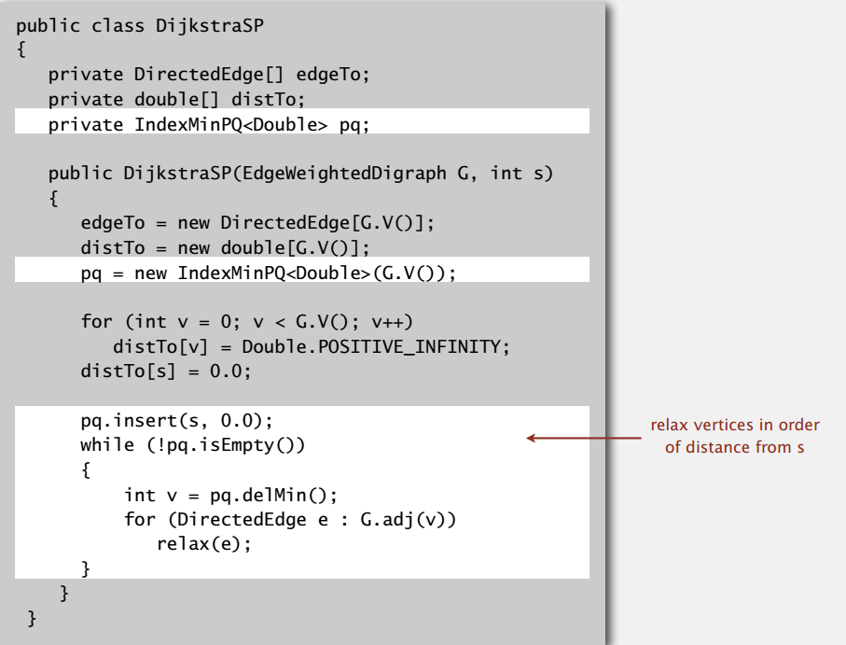
Dijkstra’s Algorithm: Implementation

Slide 16
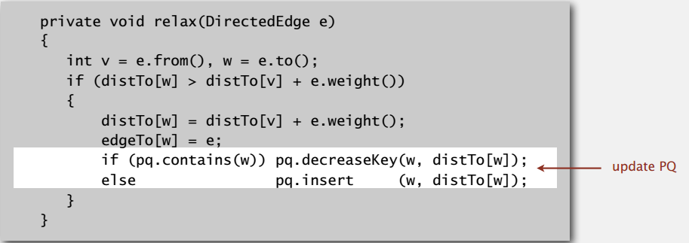
Dijkstra’s Algorithm: Implementation (cont.)

Slide 17
Quiz
What is the order of growth of the running time of Dijkstra’s algorithm when using a binary heap for the priority queue?
V + E
V log E
E log V
E log E
I don’t know

Slide 18
Unweighted Graph
Suppose weight(u, v) = 1 for any edge (u, v) in G, can the algorithm be improved?
Use a FIFO queue instead of a priority queue
Becomes a breadth-first search
Time is O(V + E)

Slide 19
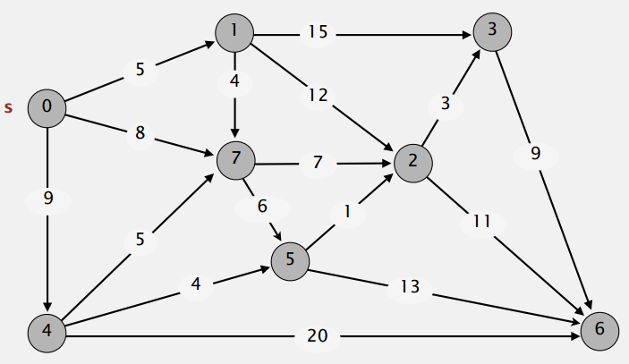
Weighted DAG
Q: Suppose that an edge-weighted digraph has no directed cycles. Is it easier to find shortest paths than in a general digraph?

Slide 20
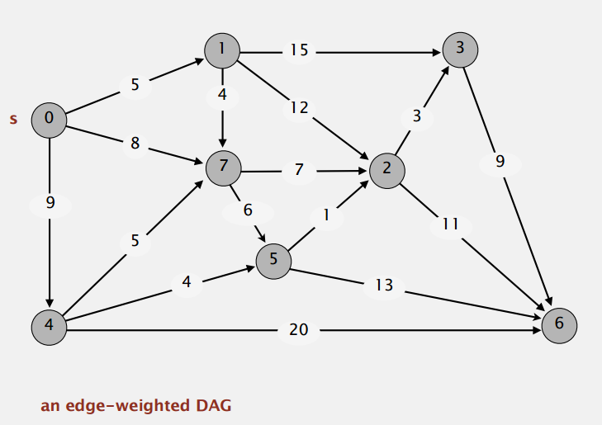
Acyclic Shortest Paths
Consider vertices in topological order
Relax all edges adjacent from that vertex

Slide 21
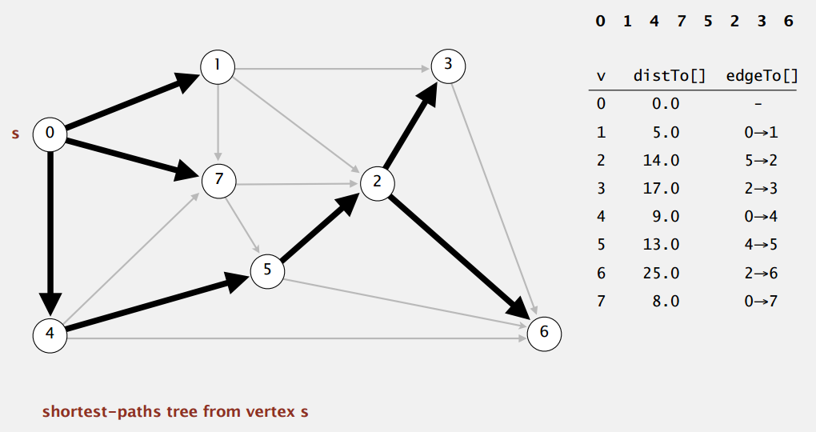
Acyclic Shortest Paths
Consider vertices in topological order
Relax all edges adjacent from that vertex

Slide 22
Acyclic Shortest Paths Example
1
1
8
0
4
8
0
4
-2
-2
3
7
2
1
4
3
8
7
2
-2
1
4
4
∞
∞
∞
∞
∞
∞
3
9
3
9
-5
∞
∞
5
-5
∞
∞
5
6
5
6
5
1
1
8
0
4
8
0
4
-2
-2
3
5
7
2
1
4
-1
3
7
2
1
4
8
-2
4
5
-2
-1
3
9
3
9
-5
1
7
5
-5
0
4
5
∞
∞
1
7
6
5
6
5
(two steps)

Slide 23
Quiz
What is the order of growth of the running time of the topological sort algorithm for computing shortest paths in an edge-weighted DAG?
V
E
V + E
V log E
I don’t know

Slide 24
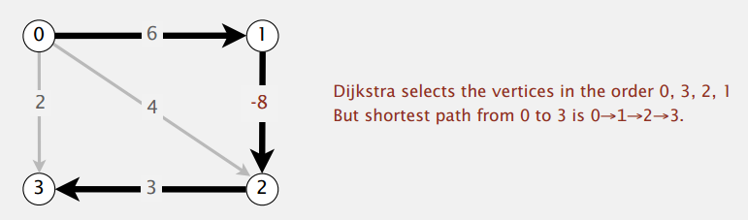
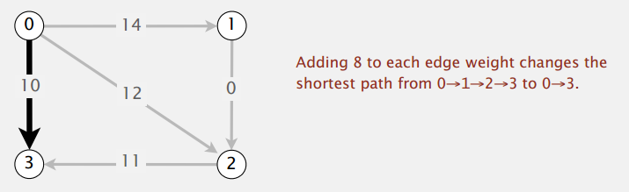
Shortest Paths with Negative Weights
Dijkstra’s algorithm does not work with negative edge weights
Adding a constant to every edge weight does not work

Slide 25
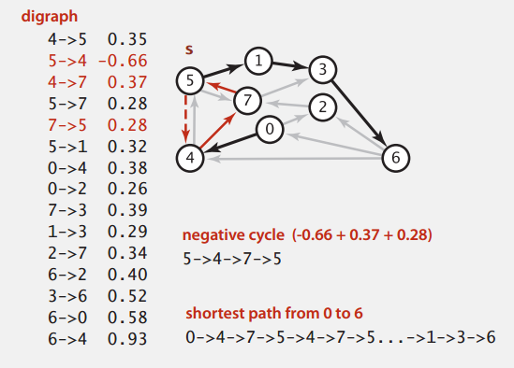
Negative Cycles
A negative cycle is a directed cycle whose sum of edge weights is negative

Slide 26
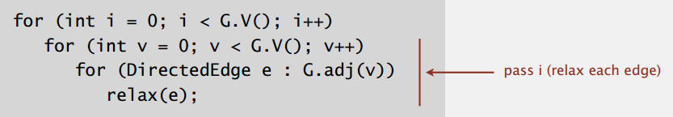
Bellman-Ford Algorithm
Initialize distTo[s] = 0 and distTo[v] = ∞ for all other vertices
Repeat V times:
Relax each edge

Slide 27
Bellman-Ford Example
8
0
4
8
0
4
-2
-2
7
1
8
7
-2
1
4
∞
∞
∞
∞
∞
∞
3
9
3
9
-2
∞
∞
5
-2
∞
∞
5
8
0
4
8
0
4
-2
-2
5
8
7
-2
1
4
-1
5
7
-2
1
-1
1
3
9
3
9
-2
6
9
5
-2
4
5
∞
∞
1
9

Slide 28
Bellman-Ford Algorithm: Analysis
Proposition: Bellman-Ford computes SPT in any edge-weighted digraph with no negative cycles in time proportional to E x V
Proof idea: After pass i, found shortest path to each vertex v for which the shortest path from s to v contains i edges (or fewer)

Slide 29
Bellman-Ford Algorithm: Improvement
If distTo[v] does not change during pass i, no need to relax any edge adjacent from v in pass i+1
FIFO implementation: Maintain queue of vertices whose distTo[] changed
Worst case is still E x V, but much faster than that in practice
How to detect negative cycles?
If Bellman-Ford updates any vertex v in pass V, there exists a negative cycle (and can trace edgeTo[v] entries back to find one)

Slide 30
Single Source Shortest Paths: Summary
Algorithm | Restriction | Typical Case | Worst Case | Extra Space
Topological Sort | No directed cycles | E + V | E + V | V
Dijkstra (heap) | No negative weights | E log V | E log V | V
Bellman-Ford | No negative cycles | EV | EV | V
Bellman-Ford (queue) |  | E + V | EV | V

Slide 31
Next class
Minimum Spanning Tree
Sedgewick Ch. 4.3
Lafore p643-649

